Slide 1
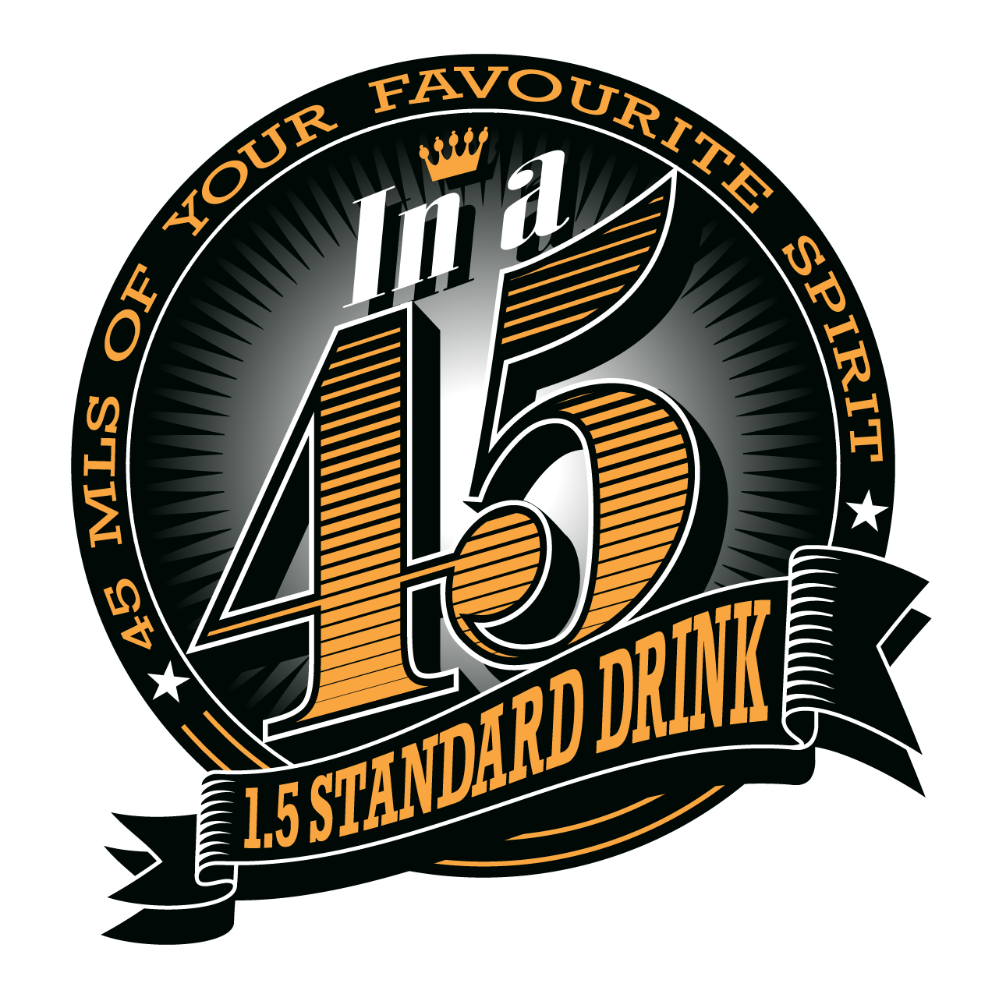
Introducing!

Slide 2
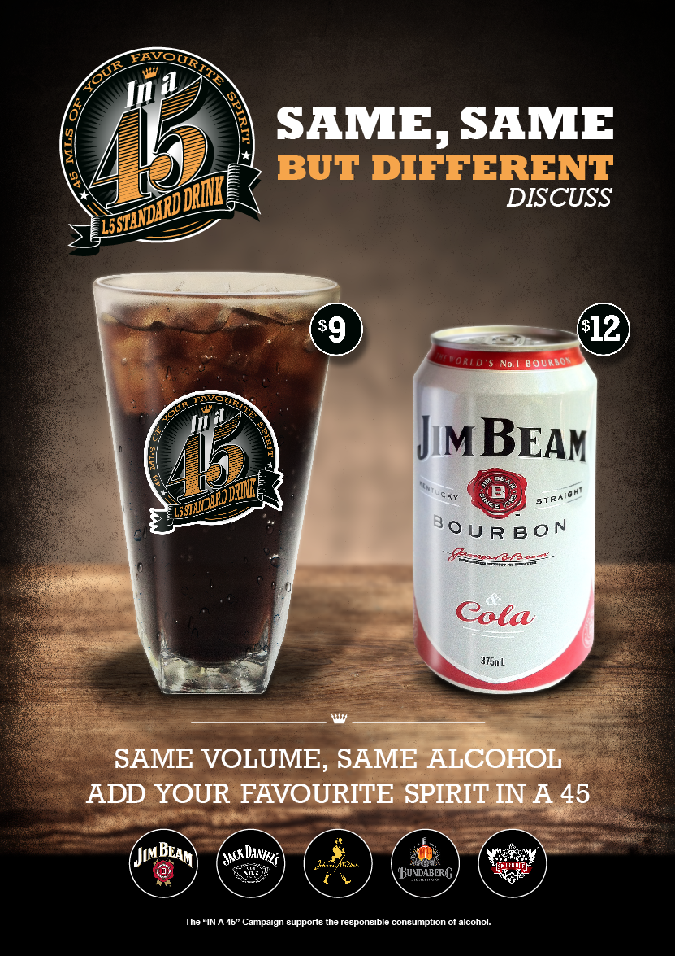
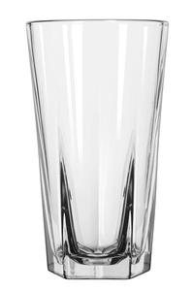
In a 45 artwork
The Glass
Libbey Inverness
451ml

Slide 3
IN A 45
What products can I use?
Jim Beam White
Jack Daniels
Johnnie Walker Red
Bundaberg Rum UP
Smirnoff Red
All with the mixer of the customers choice
Soft drink or juice!

Slide 4
IN A 45
What is it?
An alternative option for consumers who love RTD’s
Same Alcohol Content 1.5 standard drinks
Same Volume 375mls
Different Price
Why ?
It is a product that will provide a positive outcome for both the customer and the Hotel
A better GP for us
A less expensive serve for the customer
Why is it called “In a 45”
The 45 refers to 45mls of spirit and the in a 45 creates a feeling that the 45 is the glassware. This creates a conversation starter as it creates a question. What does in a 45 mean?

Slide 5
IN A 45
How do I make one?
Step 1 grab a chilled 45 glass
Step 2 add 45ml of the chosen spirit
Use the jigger provided
Step 3 add 6-8 ice cubes
Step 4 Top with the customers desired mixer.
This will be 330mls which makes 375ml as per the RTD!
Step 5 serve with a smile!

Slide 6
IN A 45
What do I need to do?
Nothing but sell the product!
The glassware and Jiggers should be in venue
The Tills are set Up
There will be a 45’s Button and the 5 options will be under the 45 button
Let TG know if you have not received Glassware!
When does it Launch?
Friday the 15th November!

Slide 7
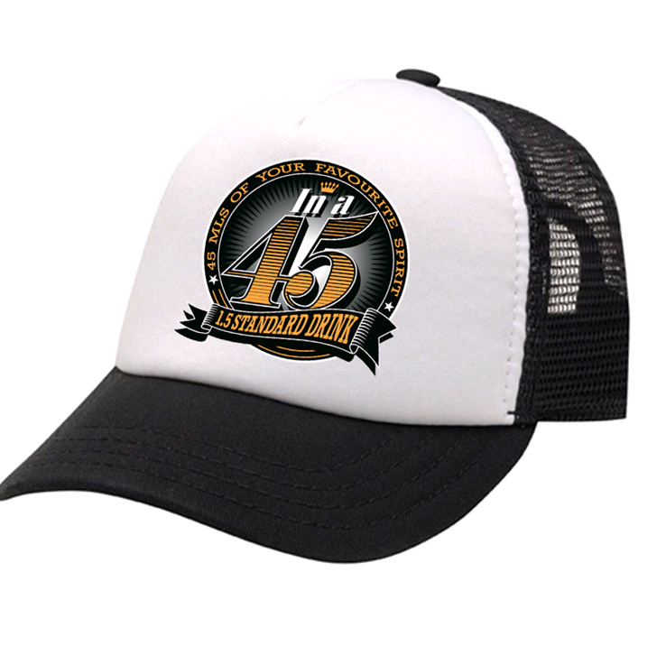
In a 45 Point of sale package
Venues will receive :
A3 poster
A4 poster
A0 poster
Nightlife screen artwork
Face book post jpeg
Coasters
Trucker caps

